Slide 1
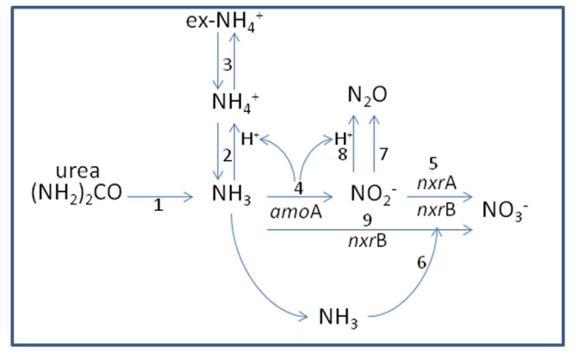
Sessoms et al, 2017
https://doi.org/10.1016/j.soilbio.2017.04.007

Slide 3
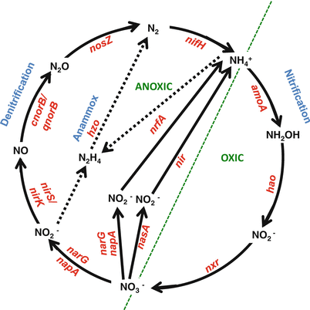
Notes:
Primers: Functional Genes for Nitrogen-Cycling Microbes in Oil Reservoirs
Book chapter : Hydrocarbon and Lipid Microbiology Protocols
C. J. Smith
B. A. McKew
A. Coggan
C. Whitby

Slide 4
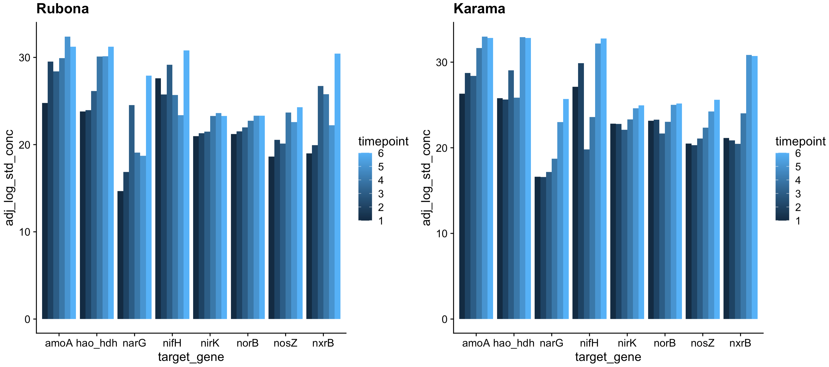
Notes:
amoA increases after harvest, but only sig in dry season?
Hao increases after harvest in rainy season in Rubona but not Karama
Plot as line chart against date; facet by nitrification/denitrification

Slide 5
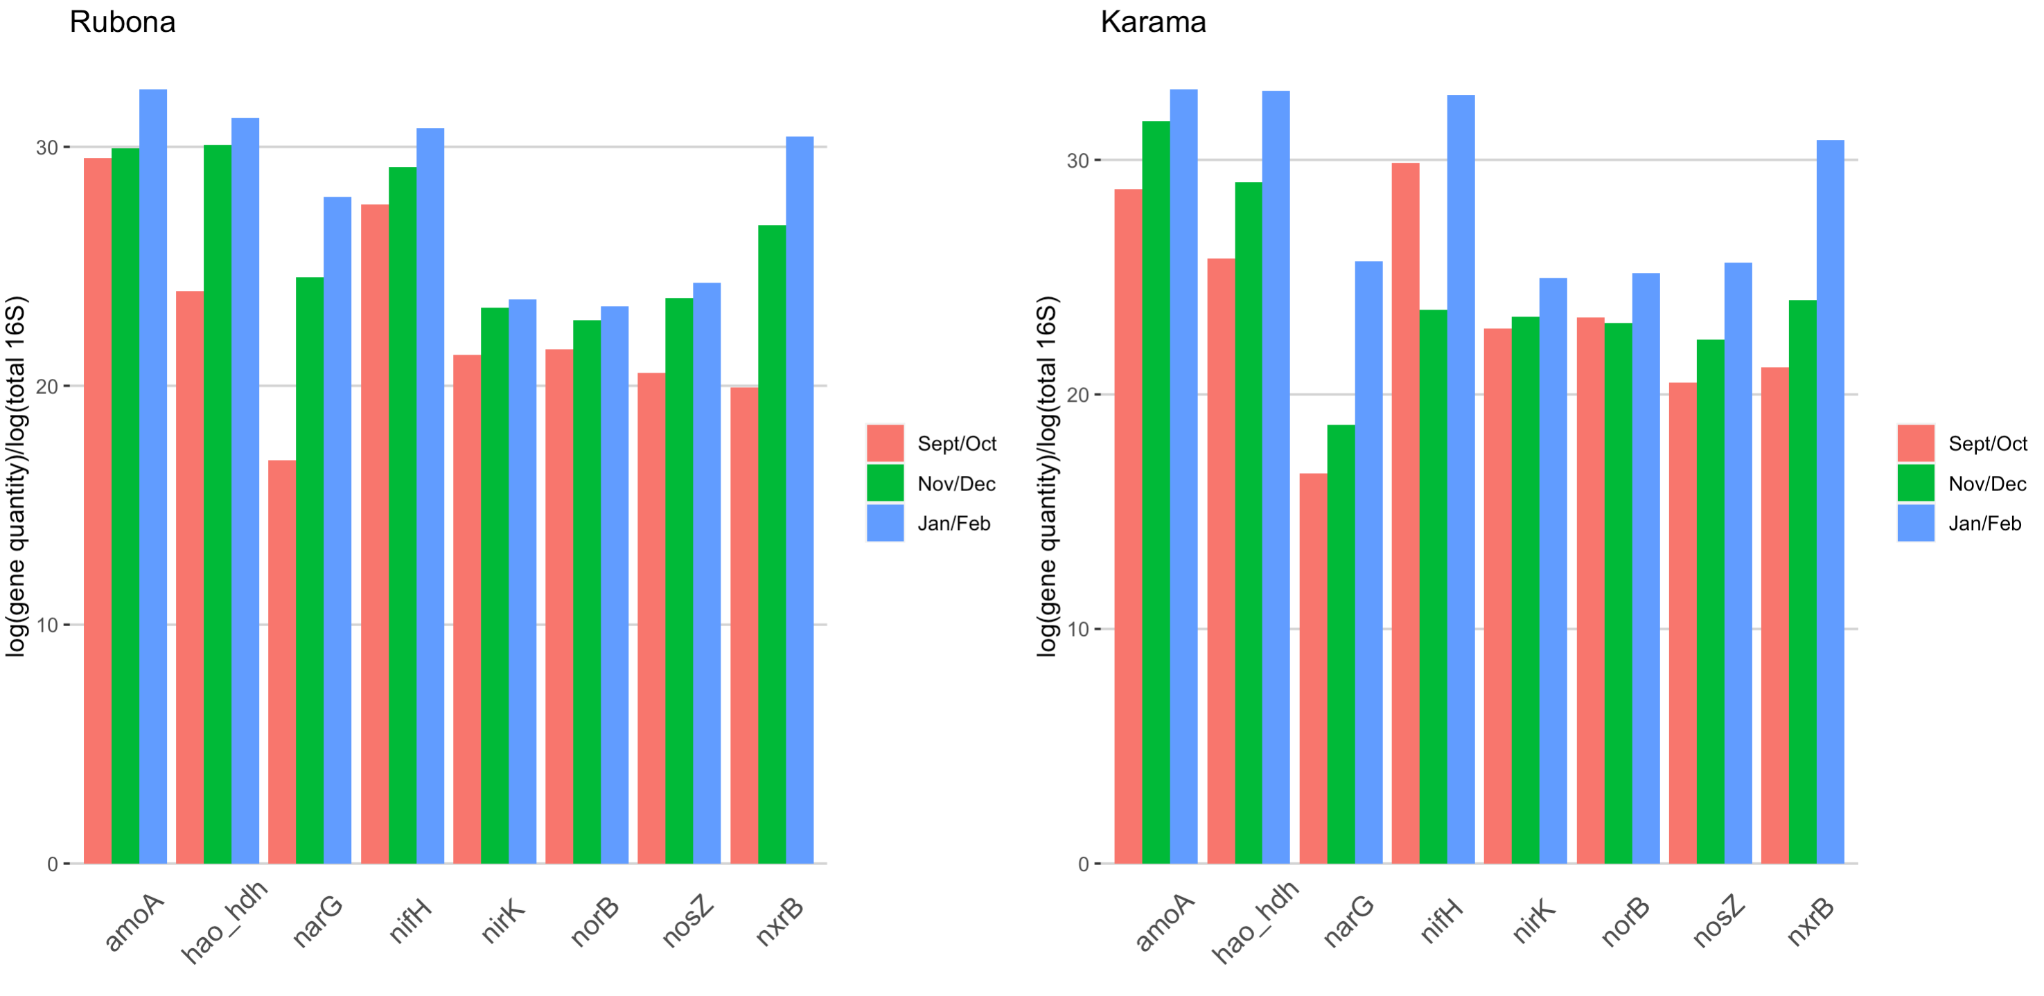

Slide 6
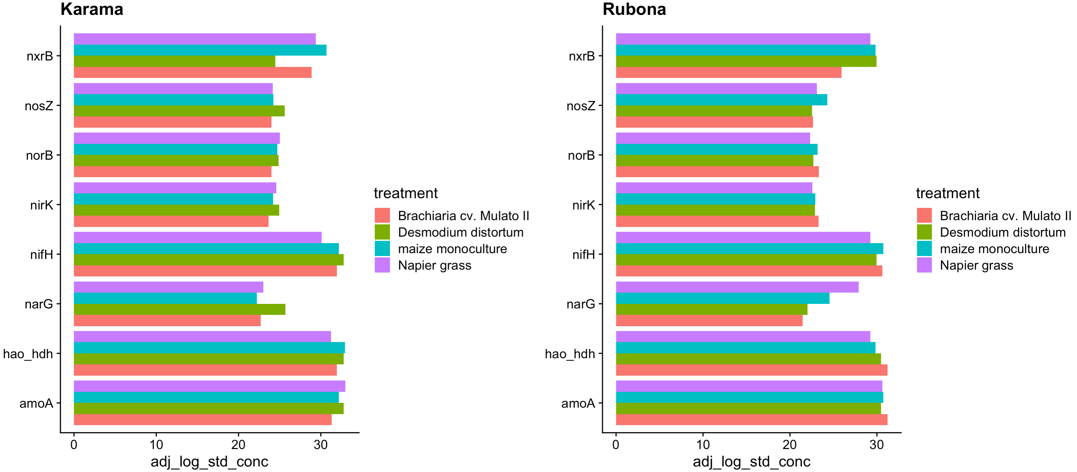

Slide 7
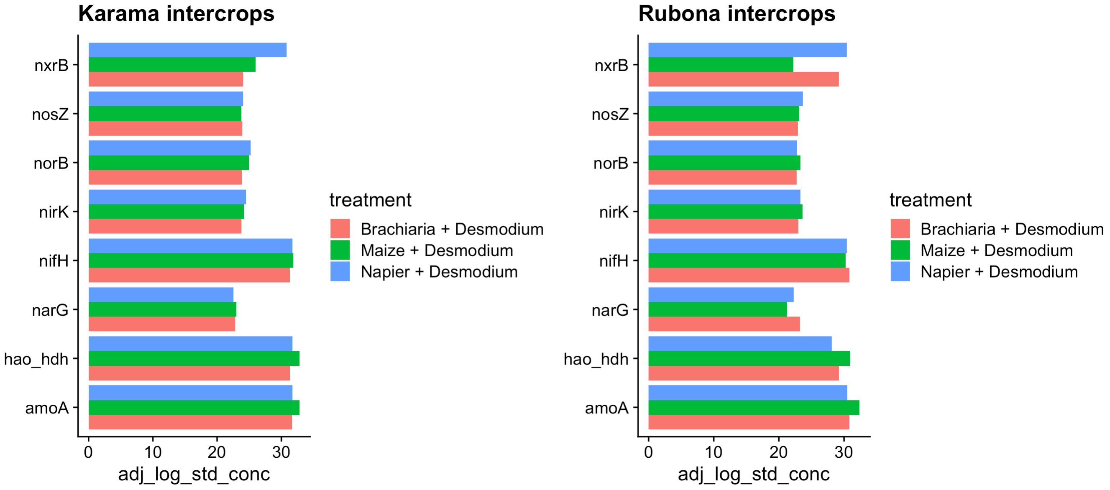

Slide 8
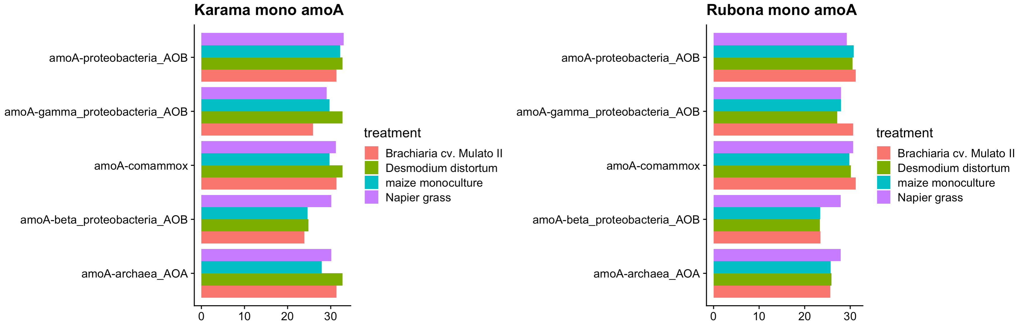

Slide 9
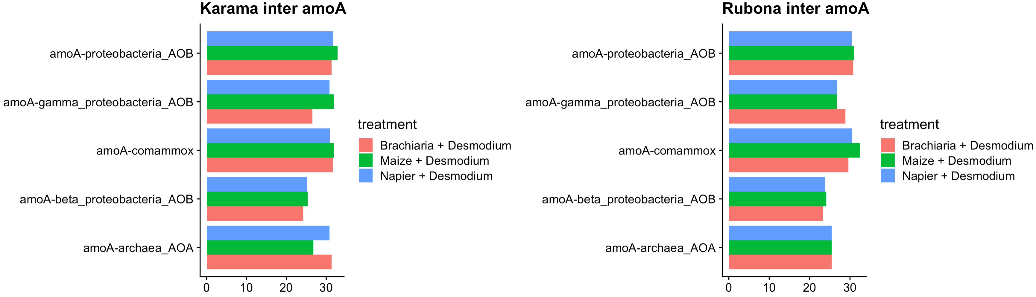

Slide 10
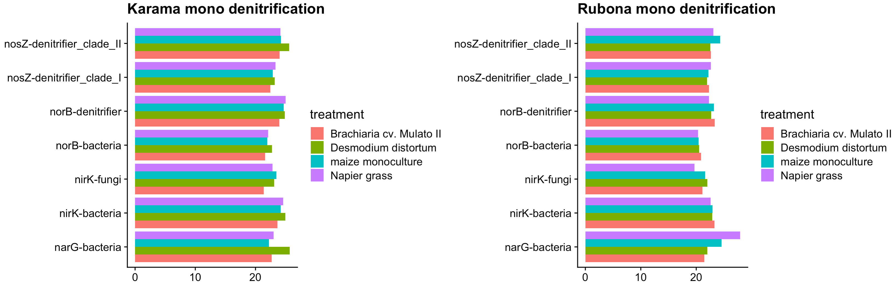

Slide 11
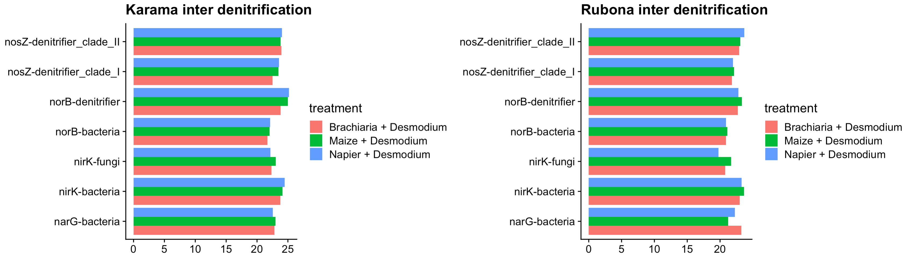

Slide 12
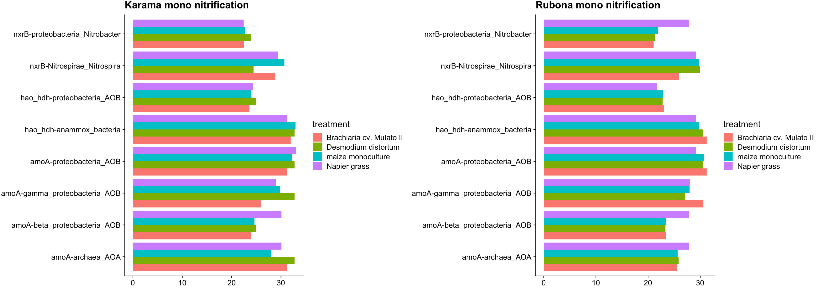

Slide 13
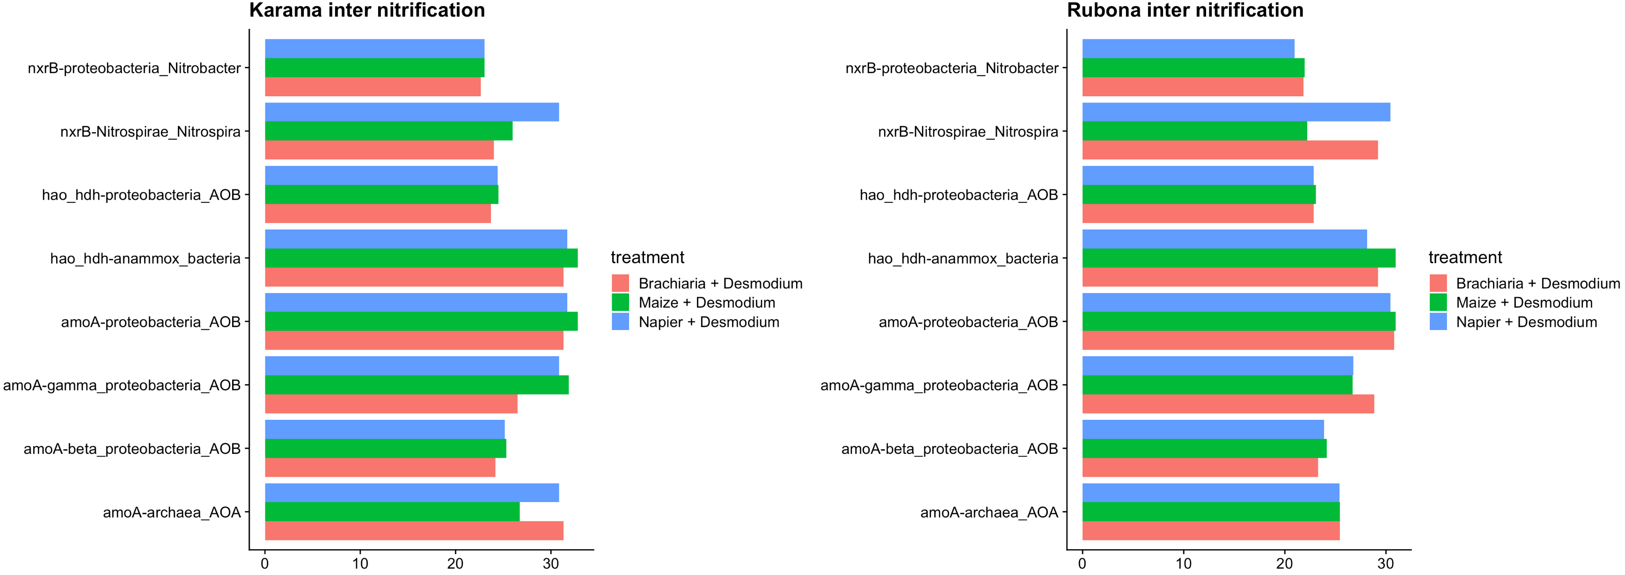

Slide 14
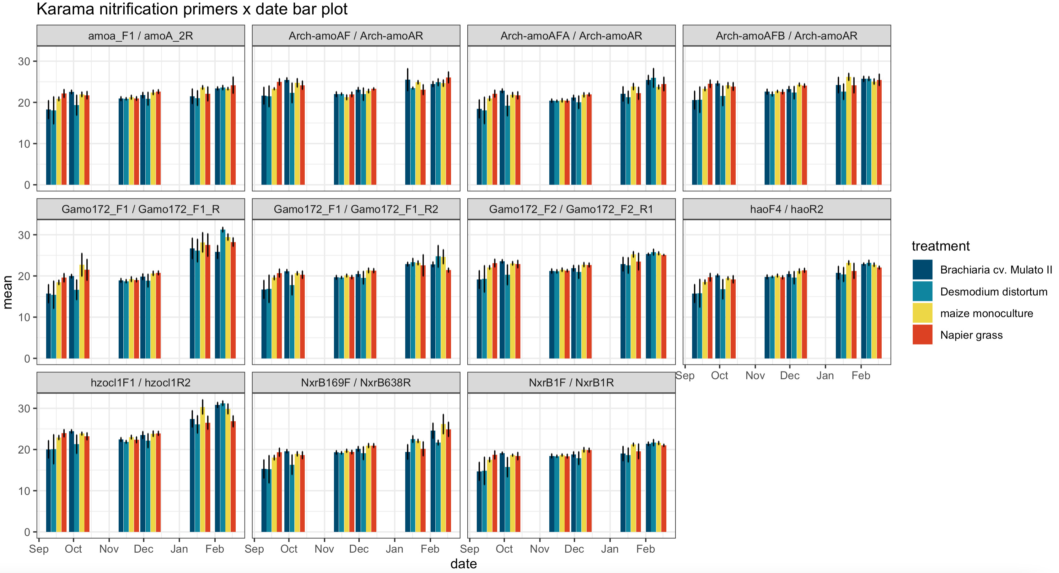
. = p<0.1
* = p<0.05
** = p<0.01
*** = p<0.001
Notes:
Suggests that plant effect is greater when soil moisture is limiting
Inlcude on poster and 5-min talk with significance from univariate ANOVA testing
Only showing sig contrasts for Brachiaria treatment

Slide 15
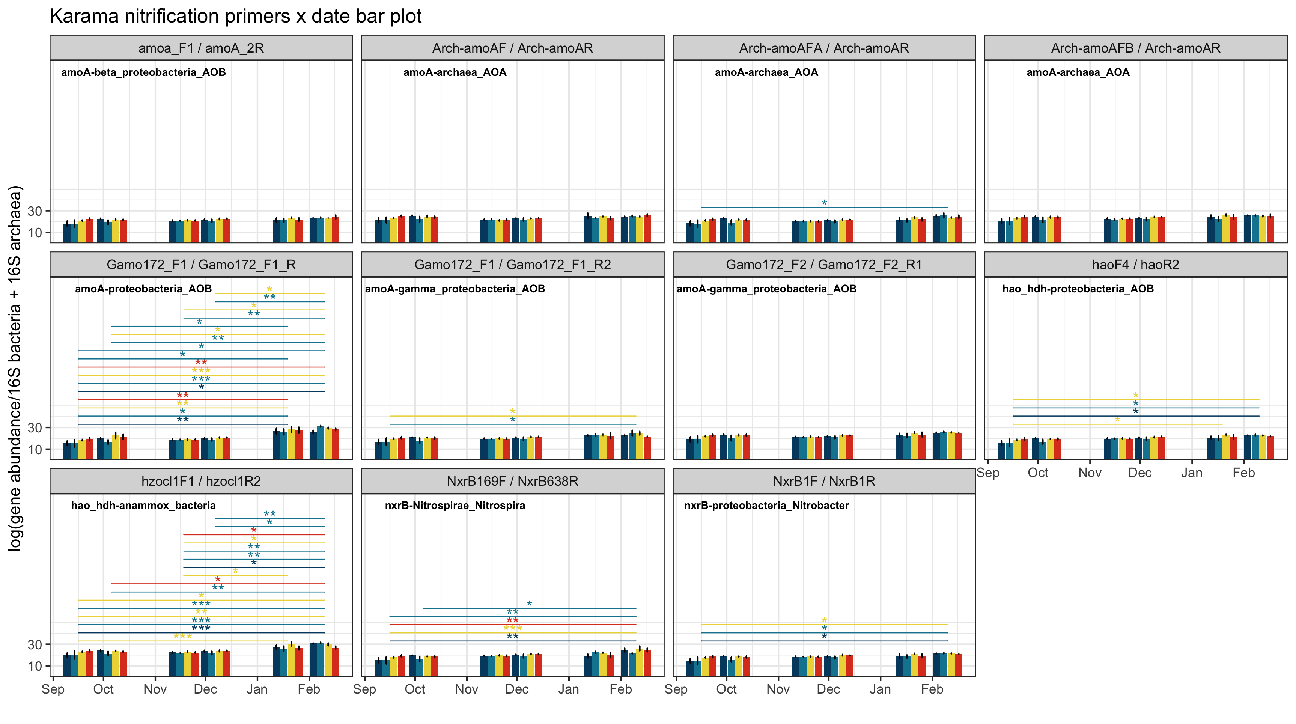

Slide 16
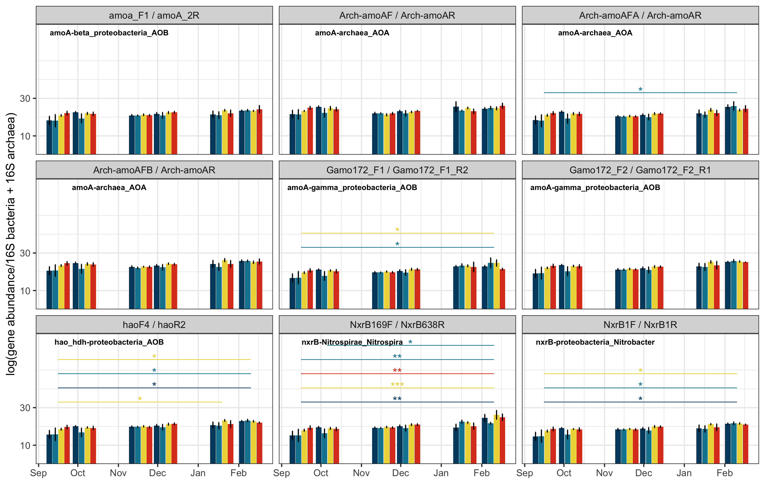
Notes:
Karama without gamo/hzo

Slide 17
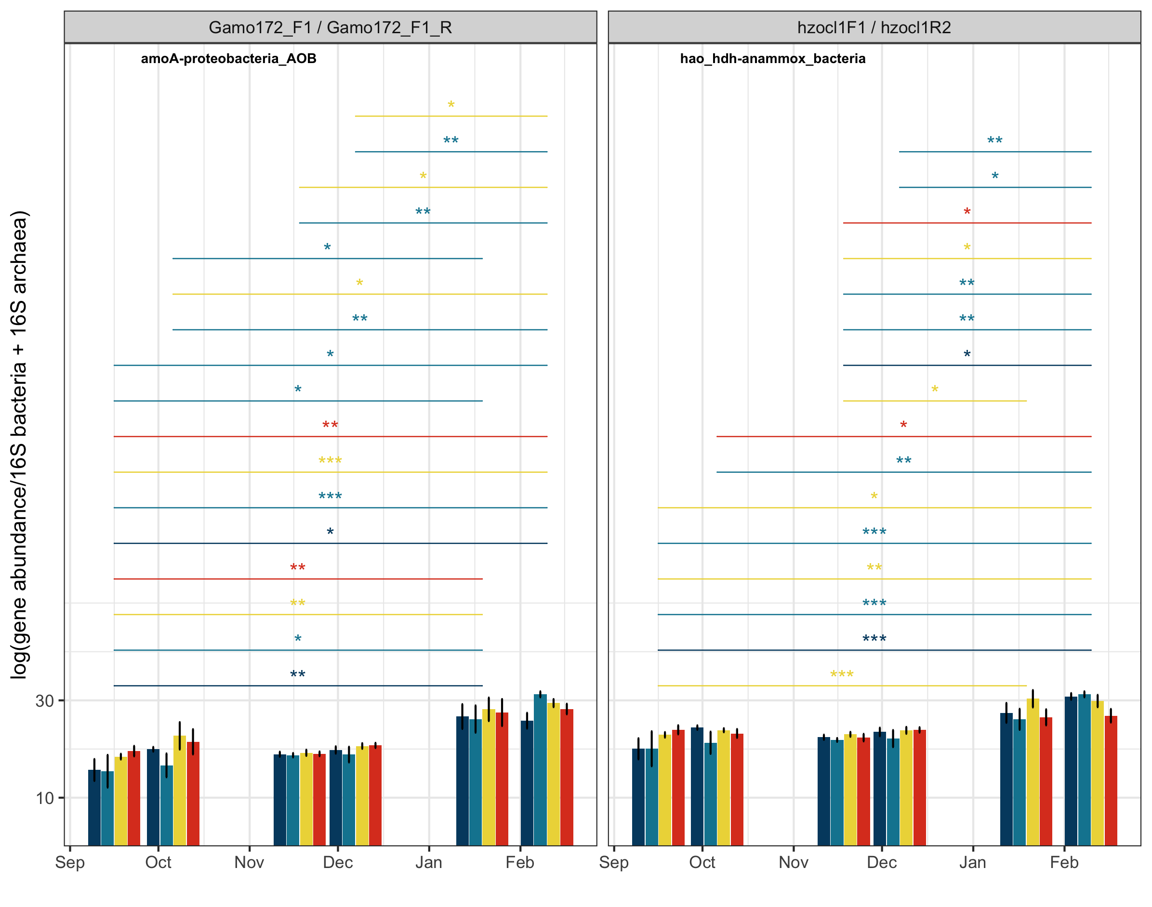
Notes:
Karama: closer look at gamo/hzo

Slide 18
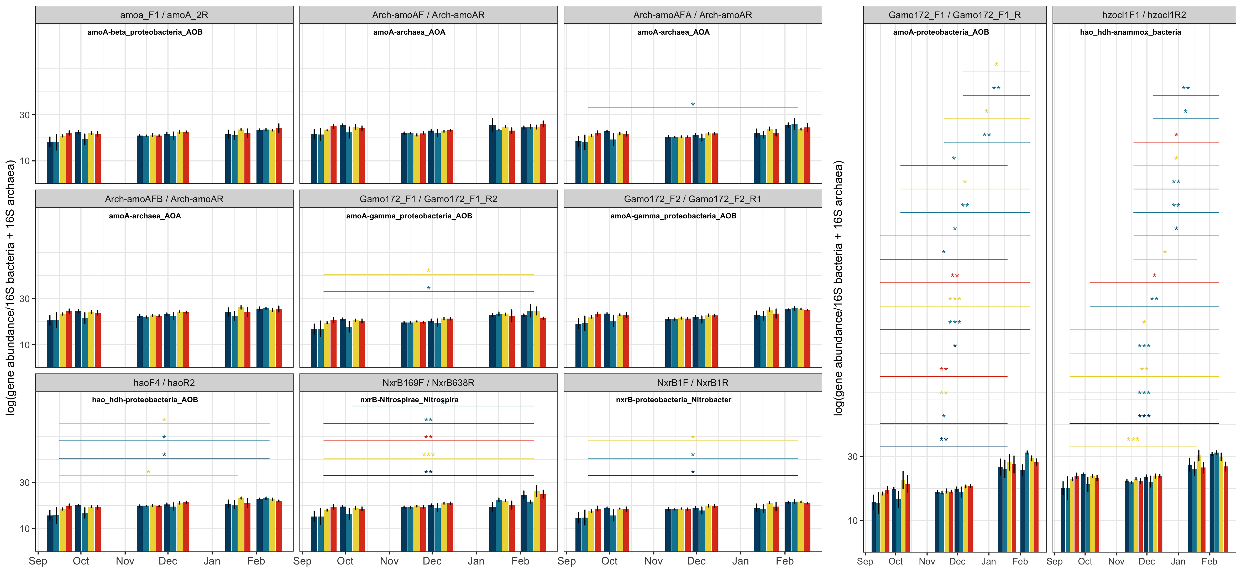
Notes:
Combined mono nit plots for karama

Slide 19
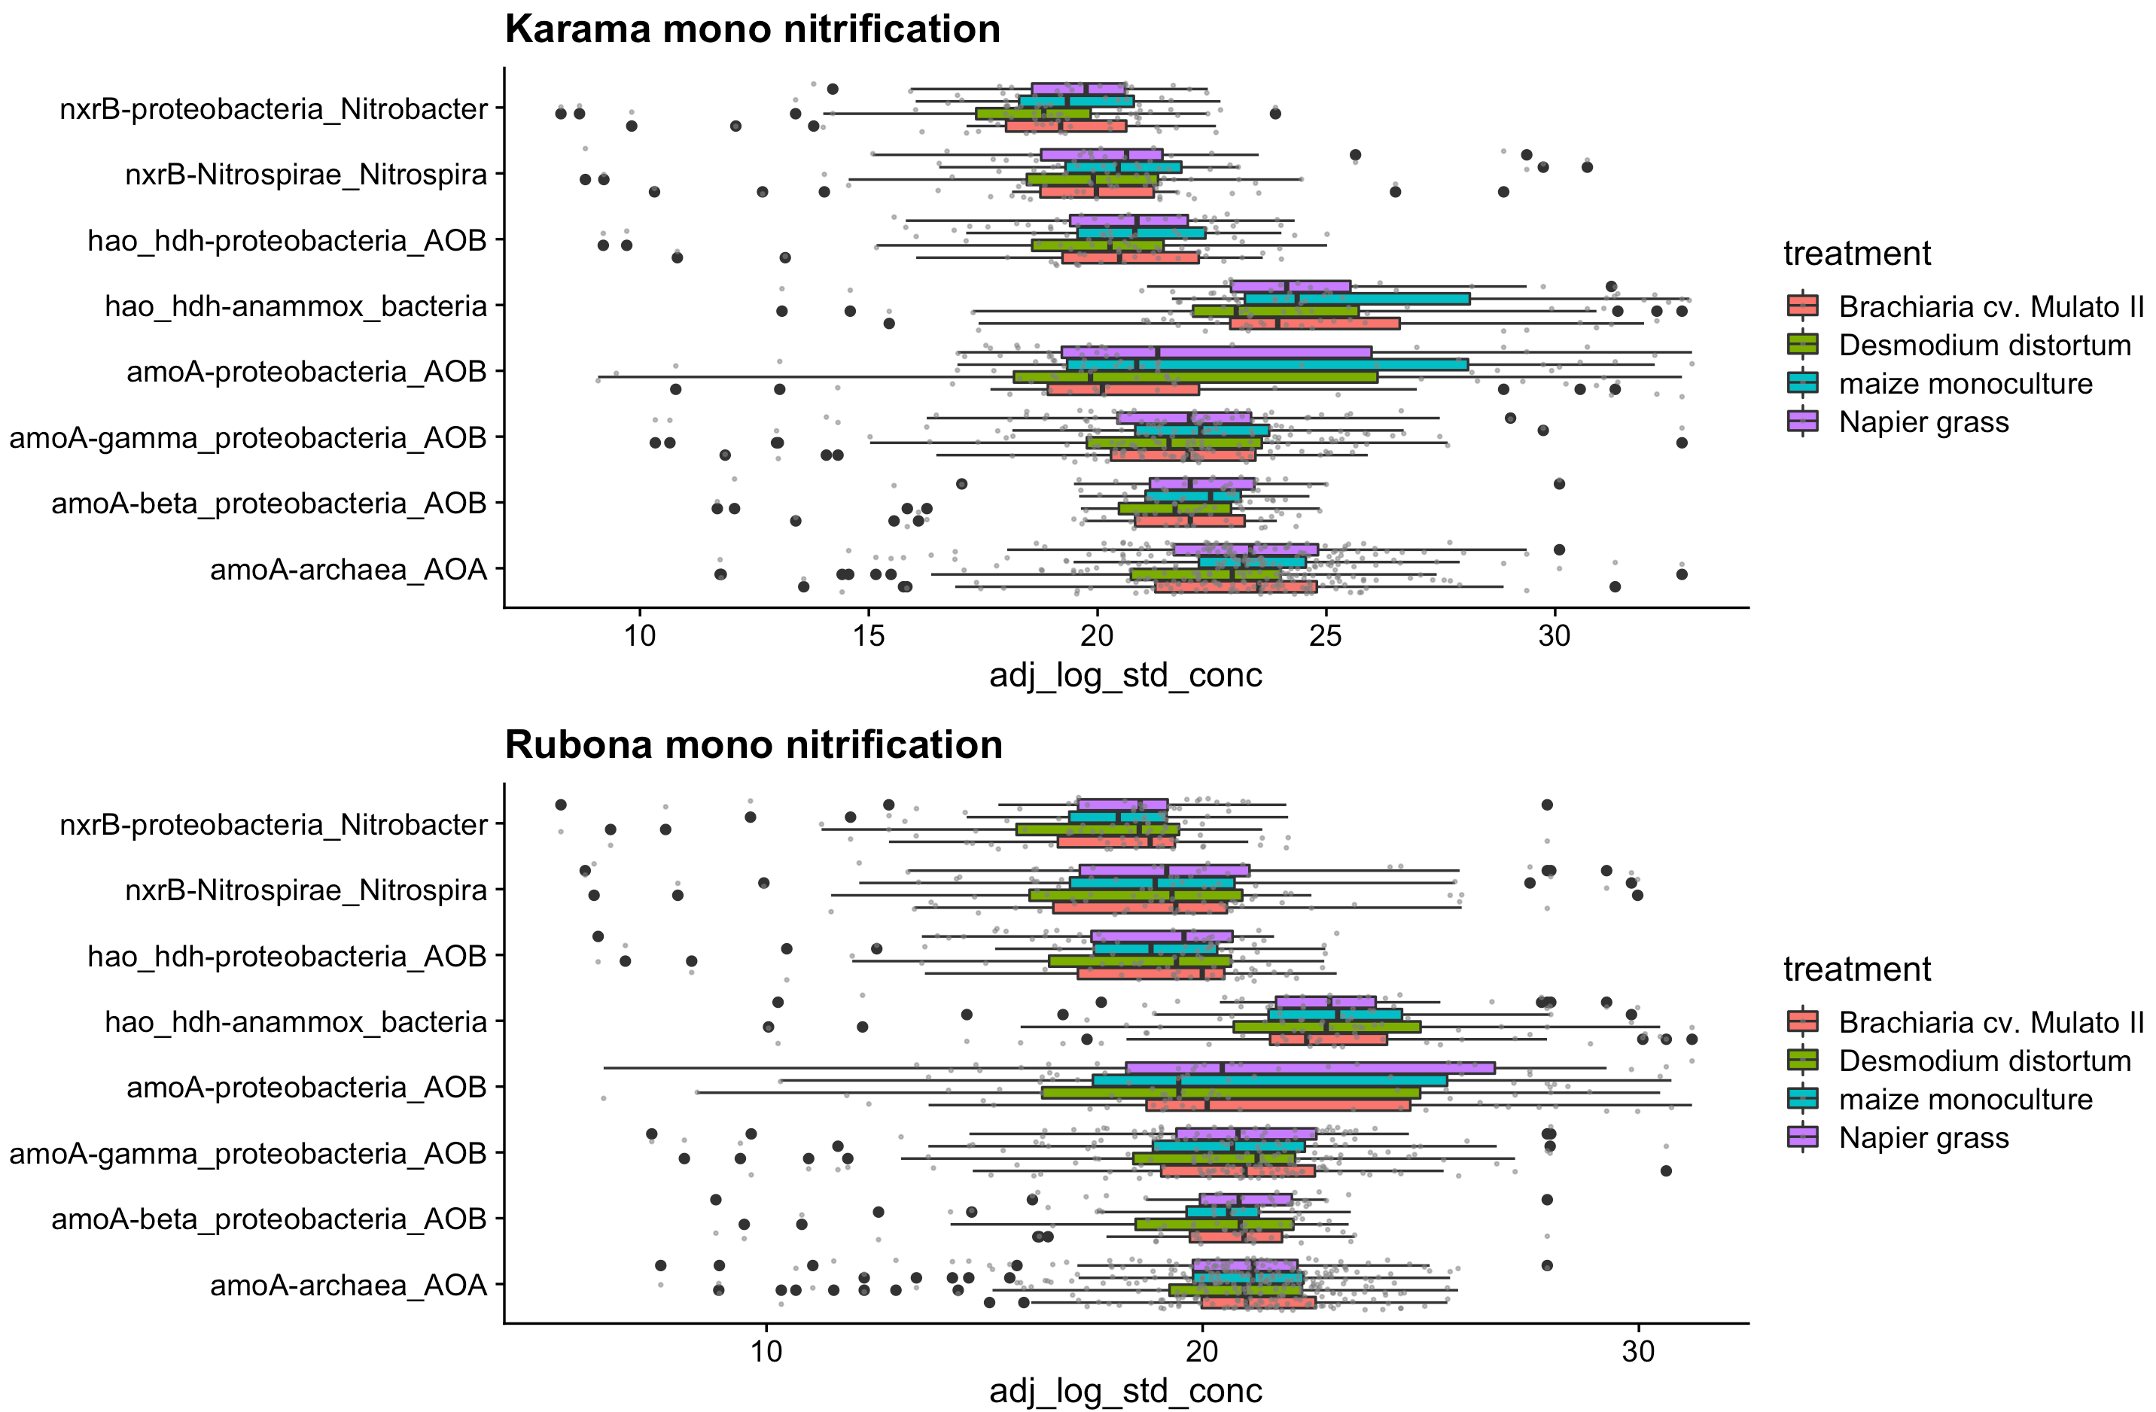

Slide 20
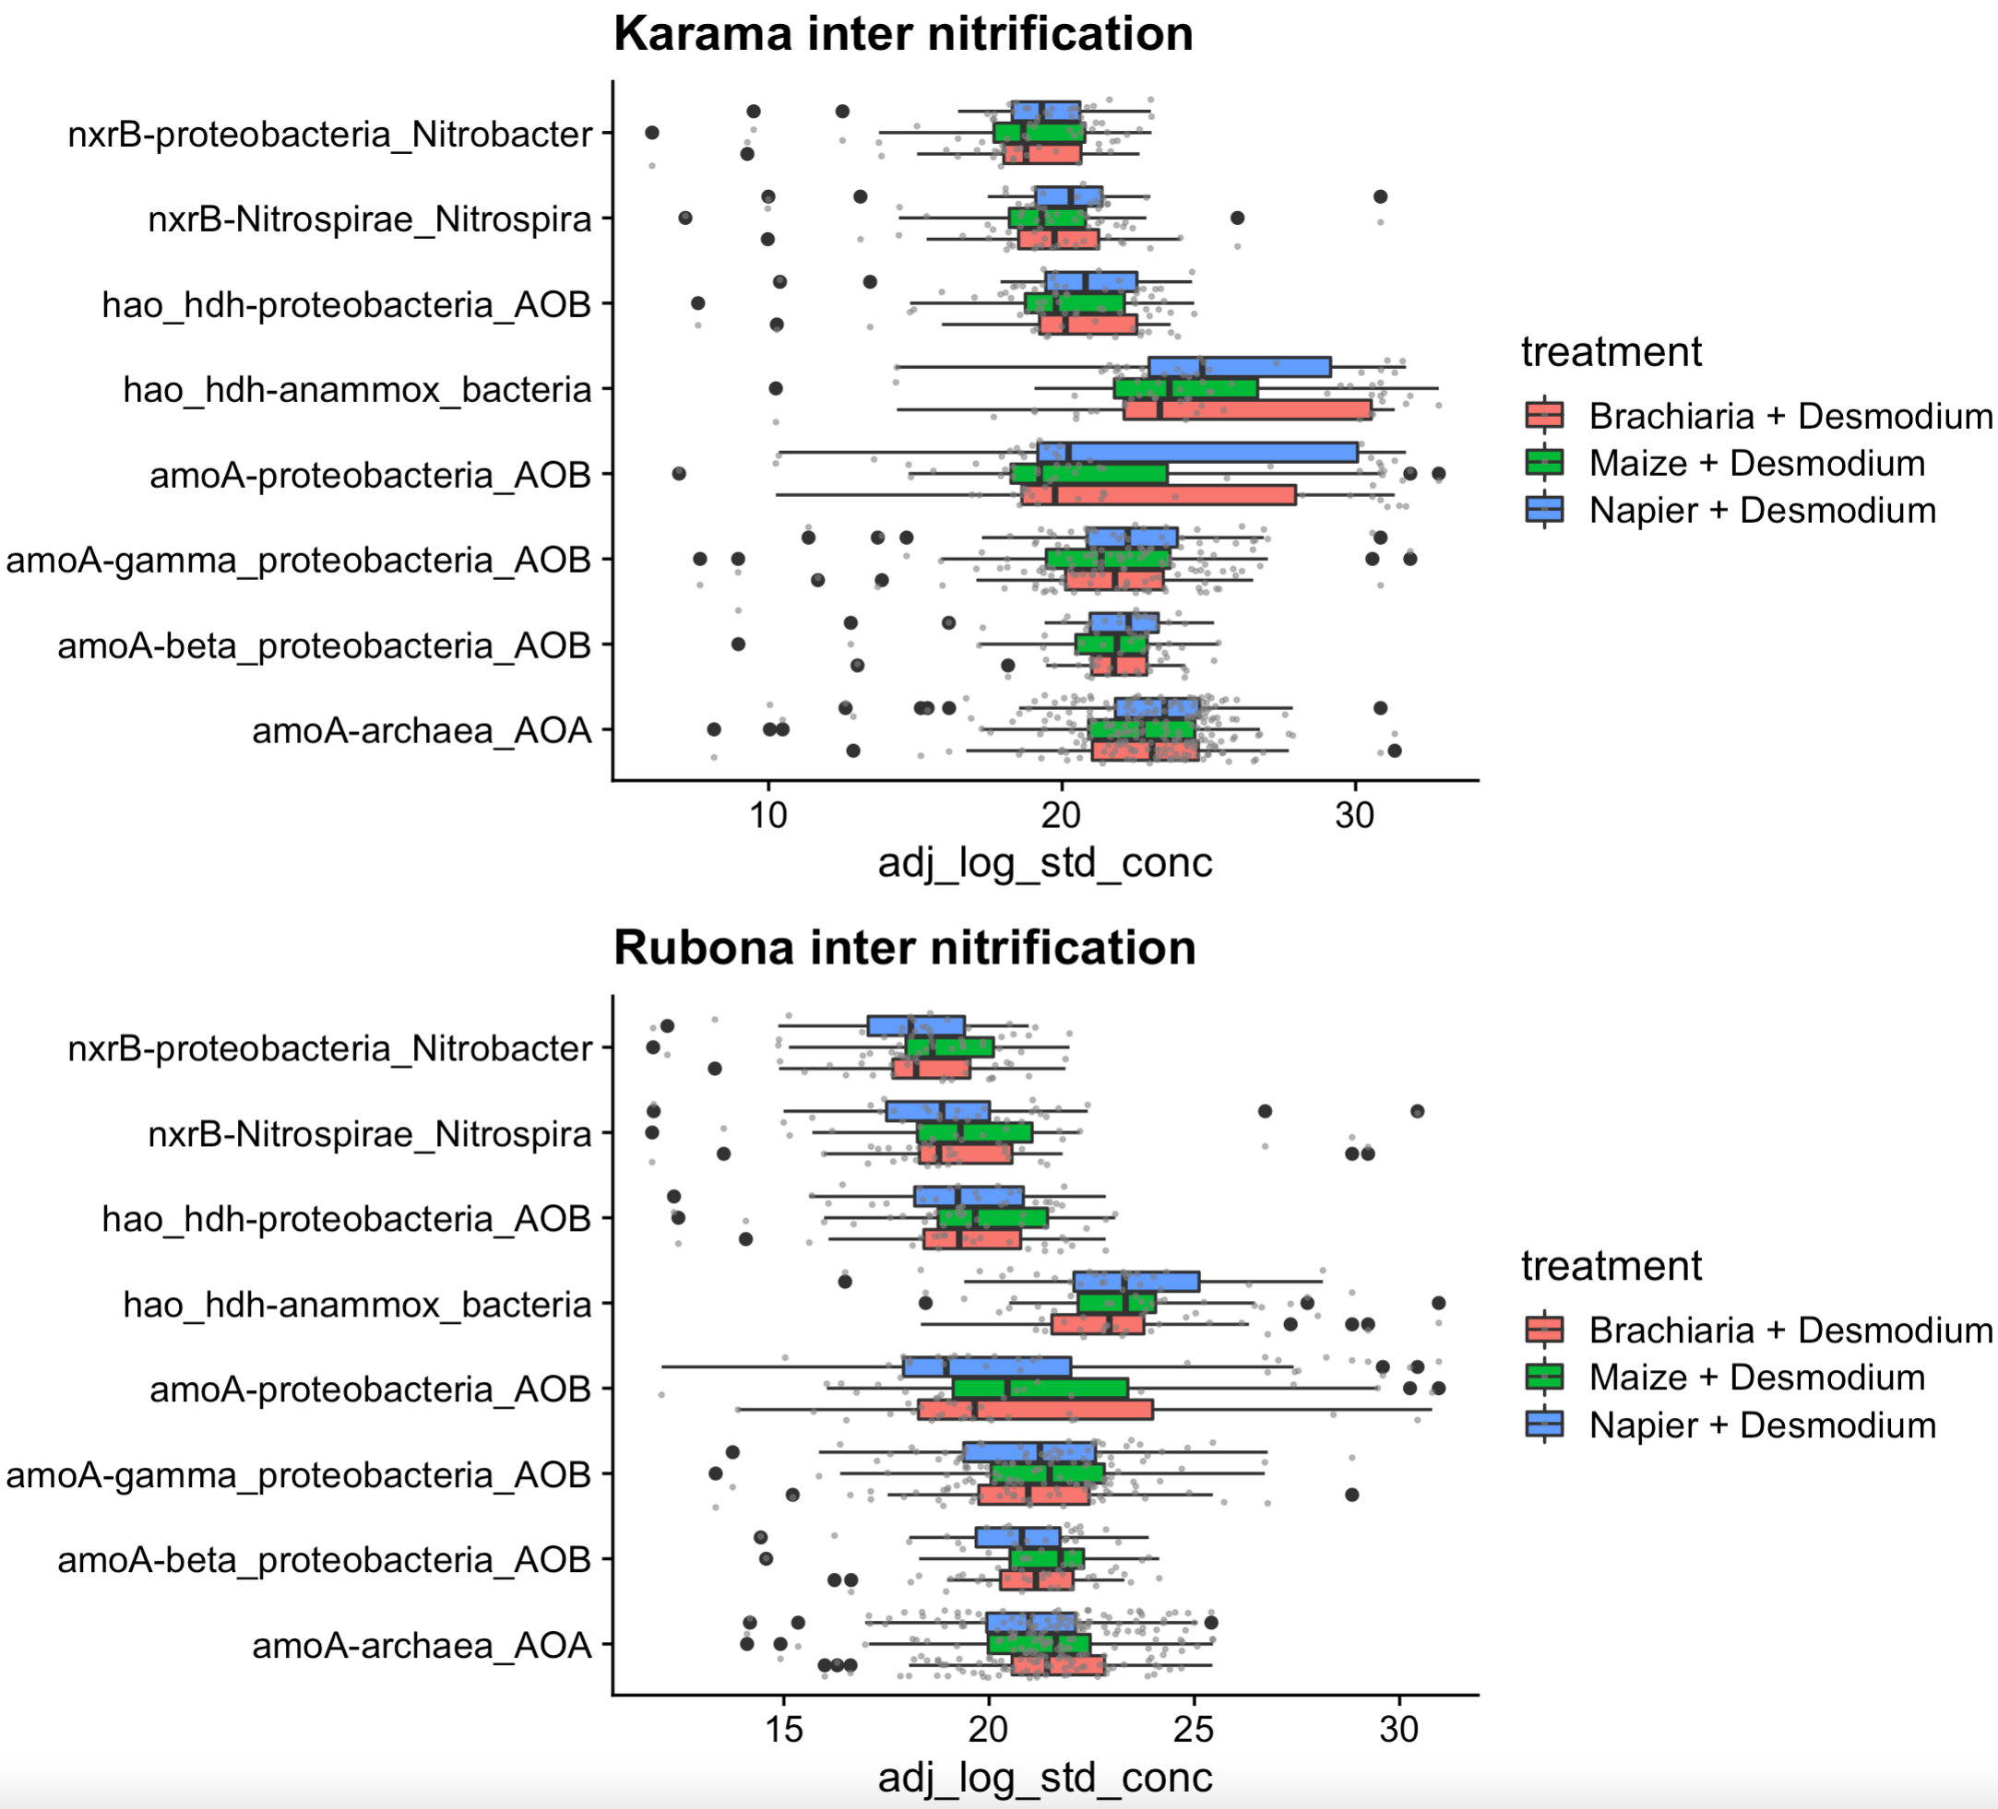

Slide 21
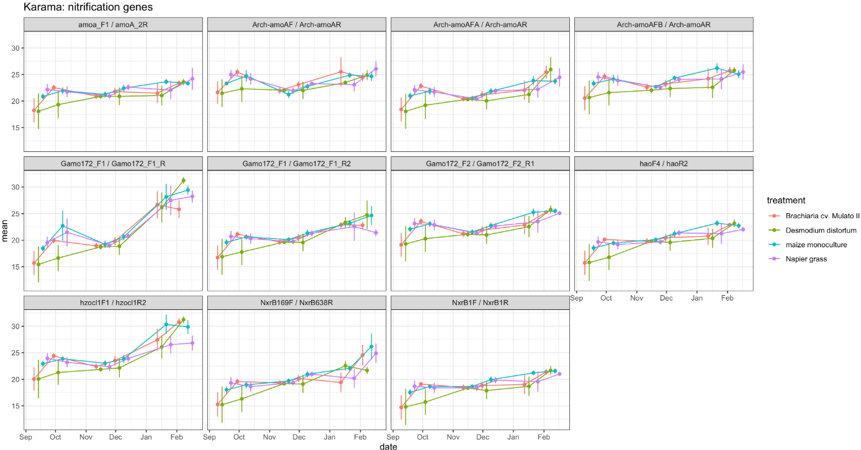
Notes:
Gamma proteobacteria responded to Brachiaria, but not AOA or beta proteoacteria
which genes accounted for the most variation in nitrification potential?

Slide 22
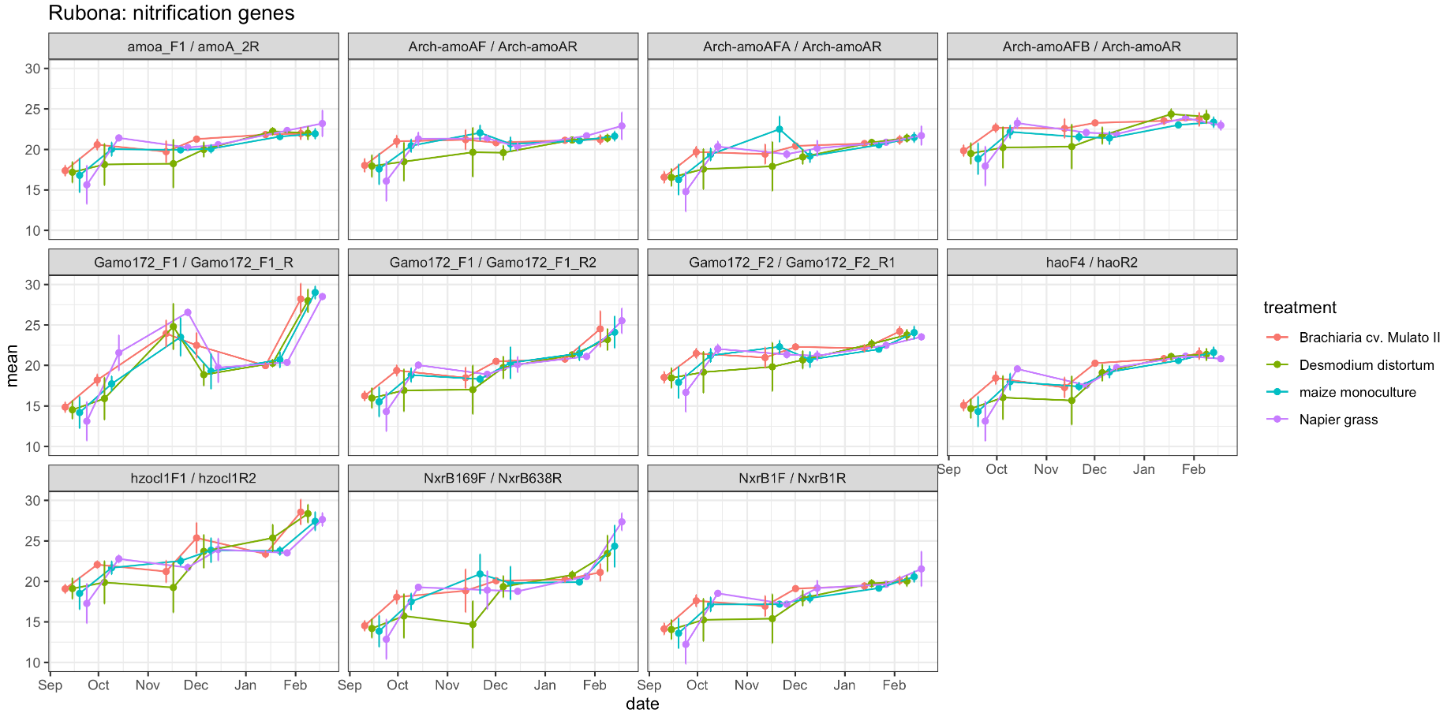

Slide 23
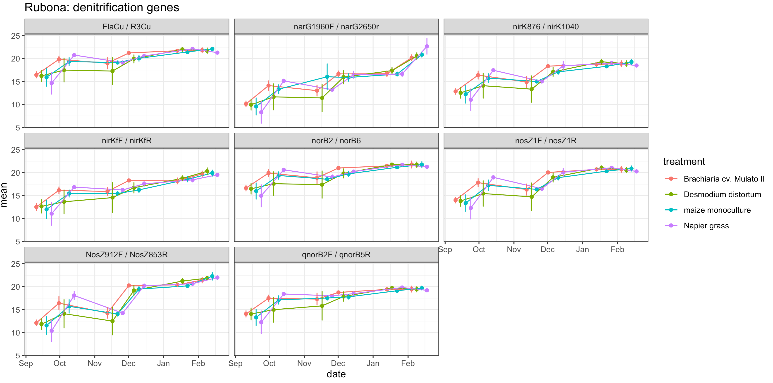

Slide 24
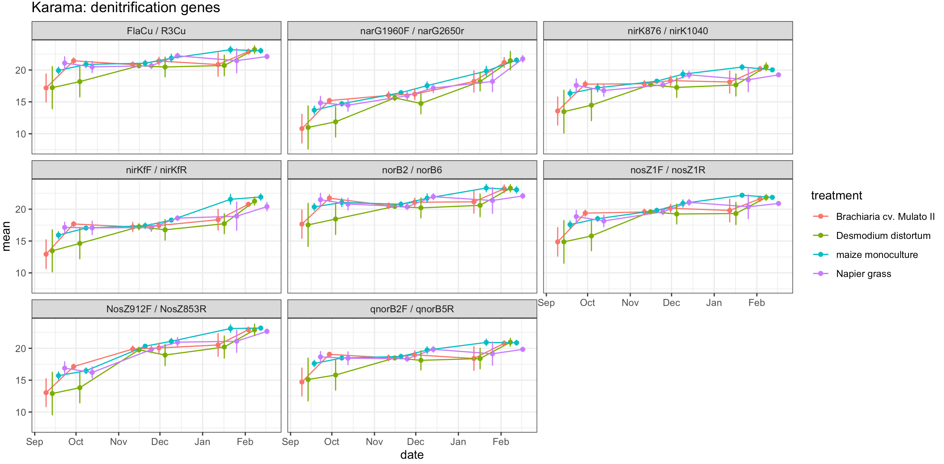

Slide 25
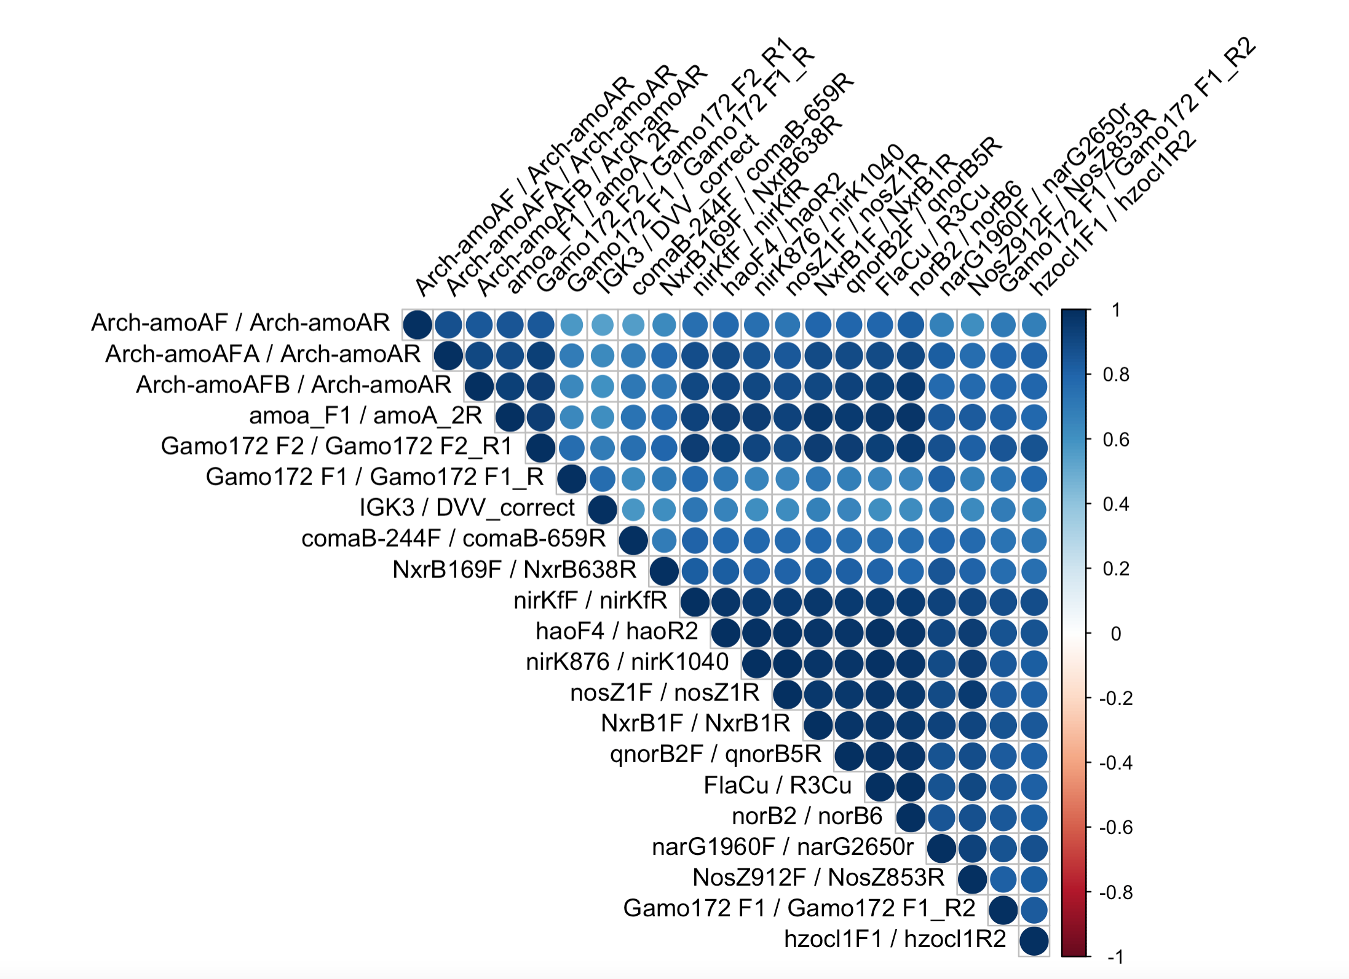
Primer correlation matrix
Pearson correlation coefficients
Notes:
nifH and commamox are less correlated with other genes

Slide 26
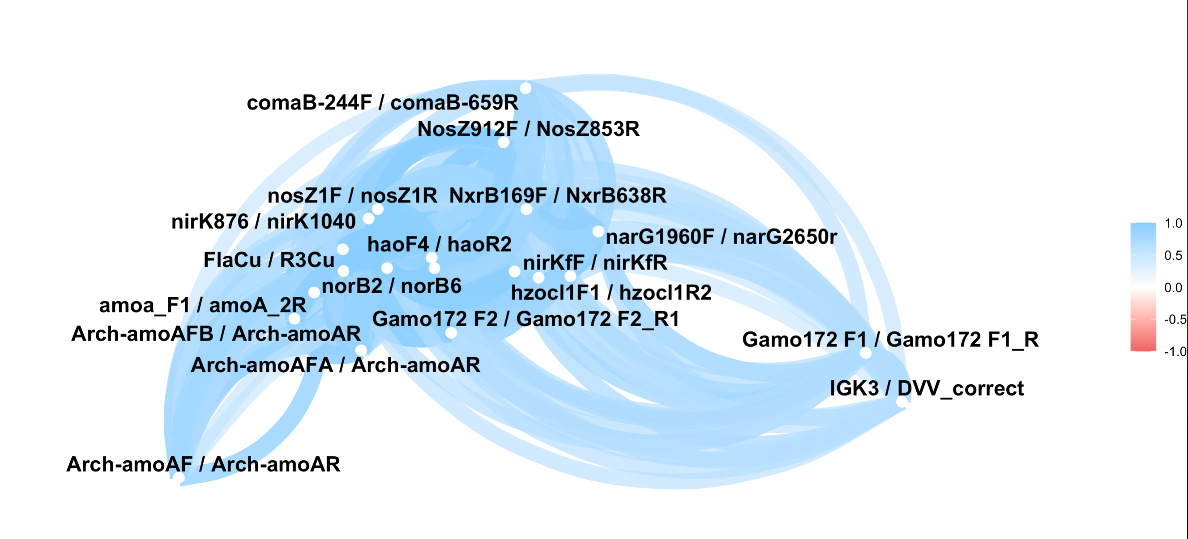
Pearson correlation network
All timepoints/trts/locations, primer_pair
Min cor = 0.3

Slide 27
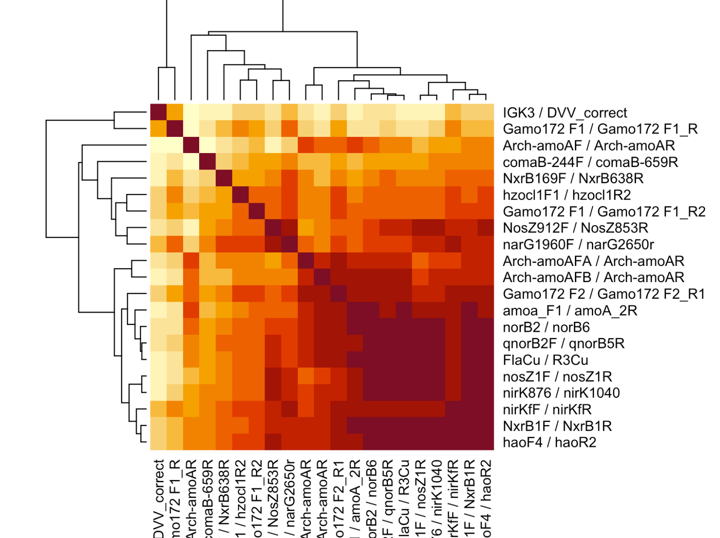
Heatmap, pearson correlation
All data, primer pairs

Slide 28
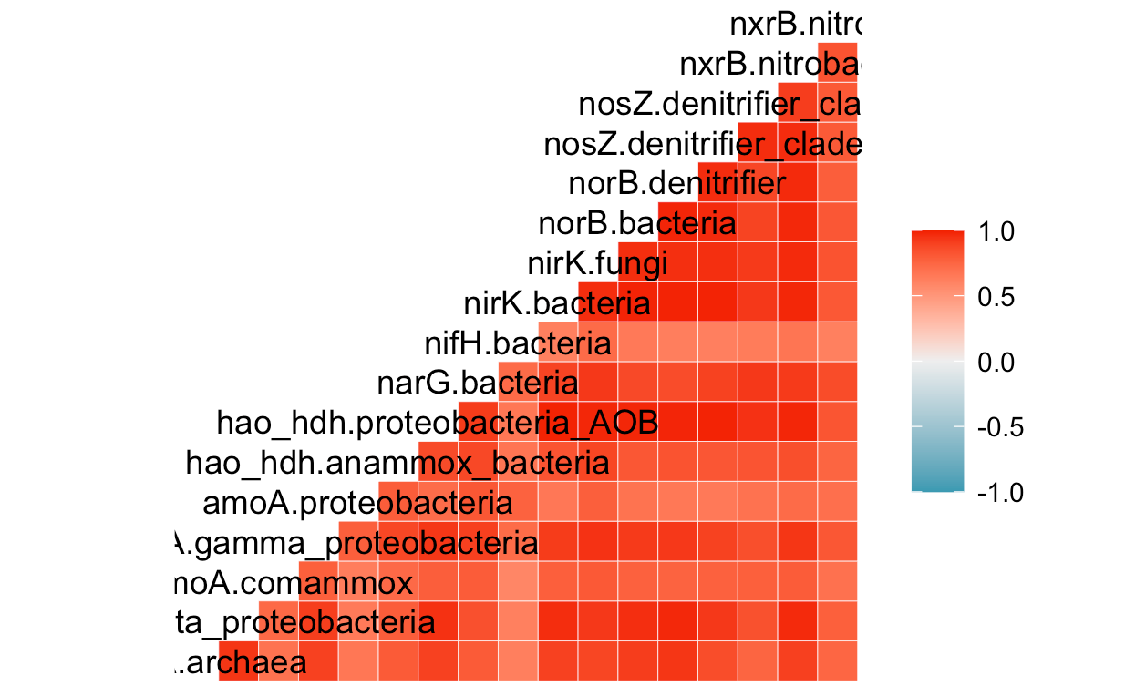
All data
Pearson coefficient
Target gene x target group

Slide 29
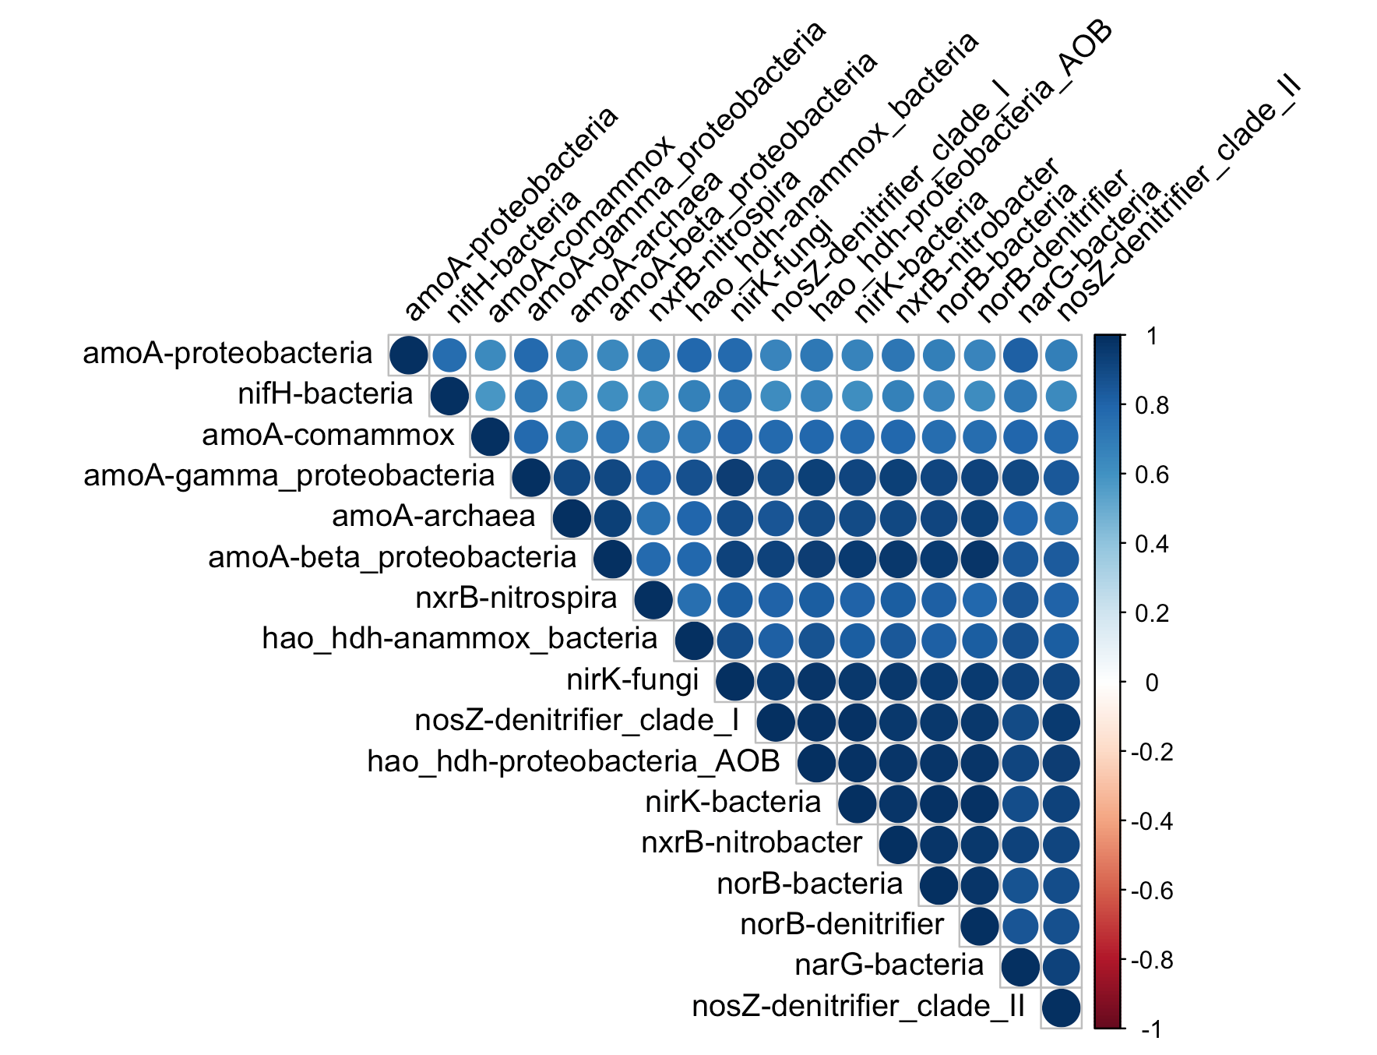
All data
Pearson coefficient
Target gene x target group
Notes:
Generate cor plot with significance; include in 5-min talk

Slide 30
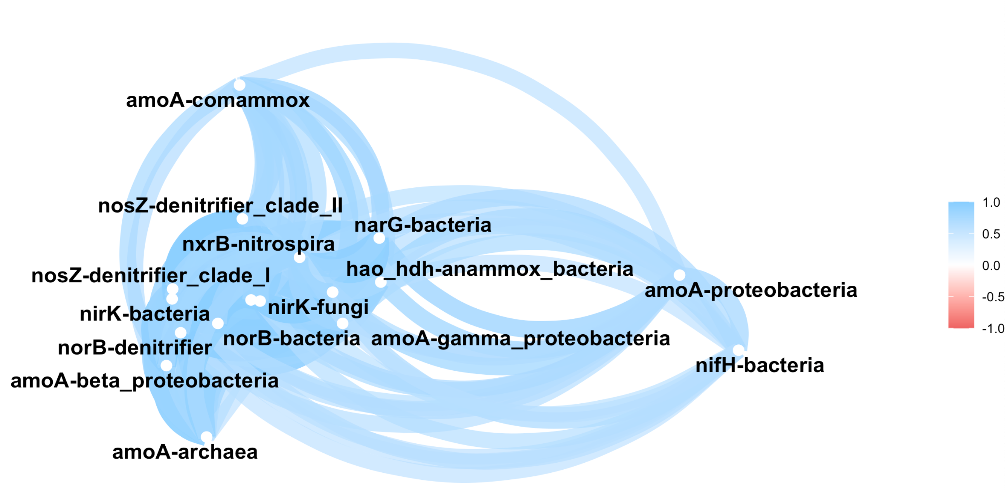
All data
Pearson coefficient
Target gene x target group
Min cor = 0.6

Slide 31
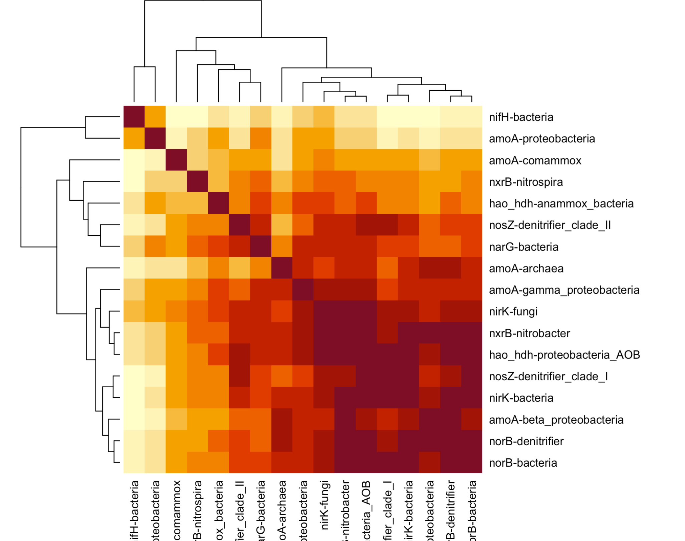
All data
Pearson coefficient
Target gene x target group

Slide 32
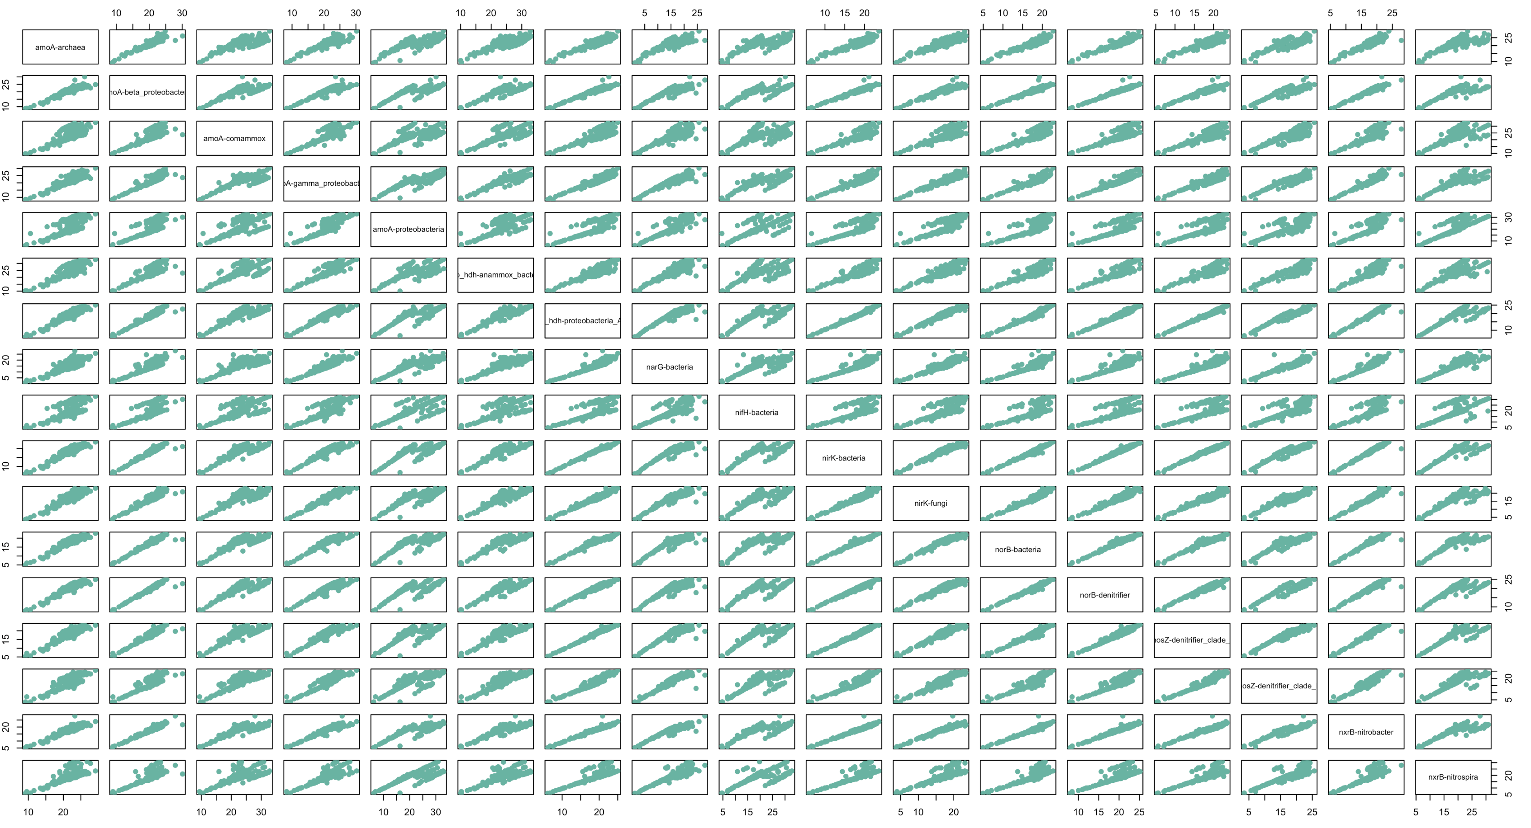

Slide 33
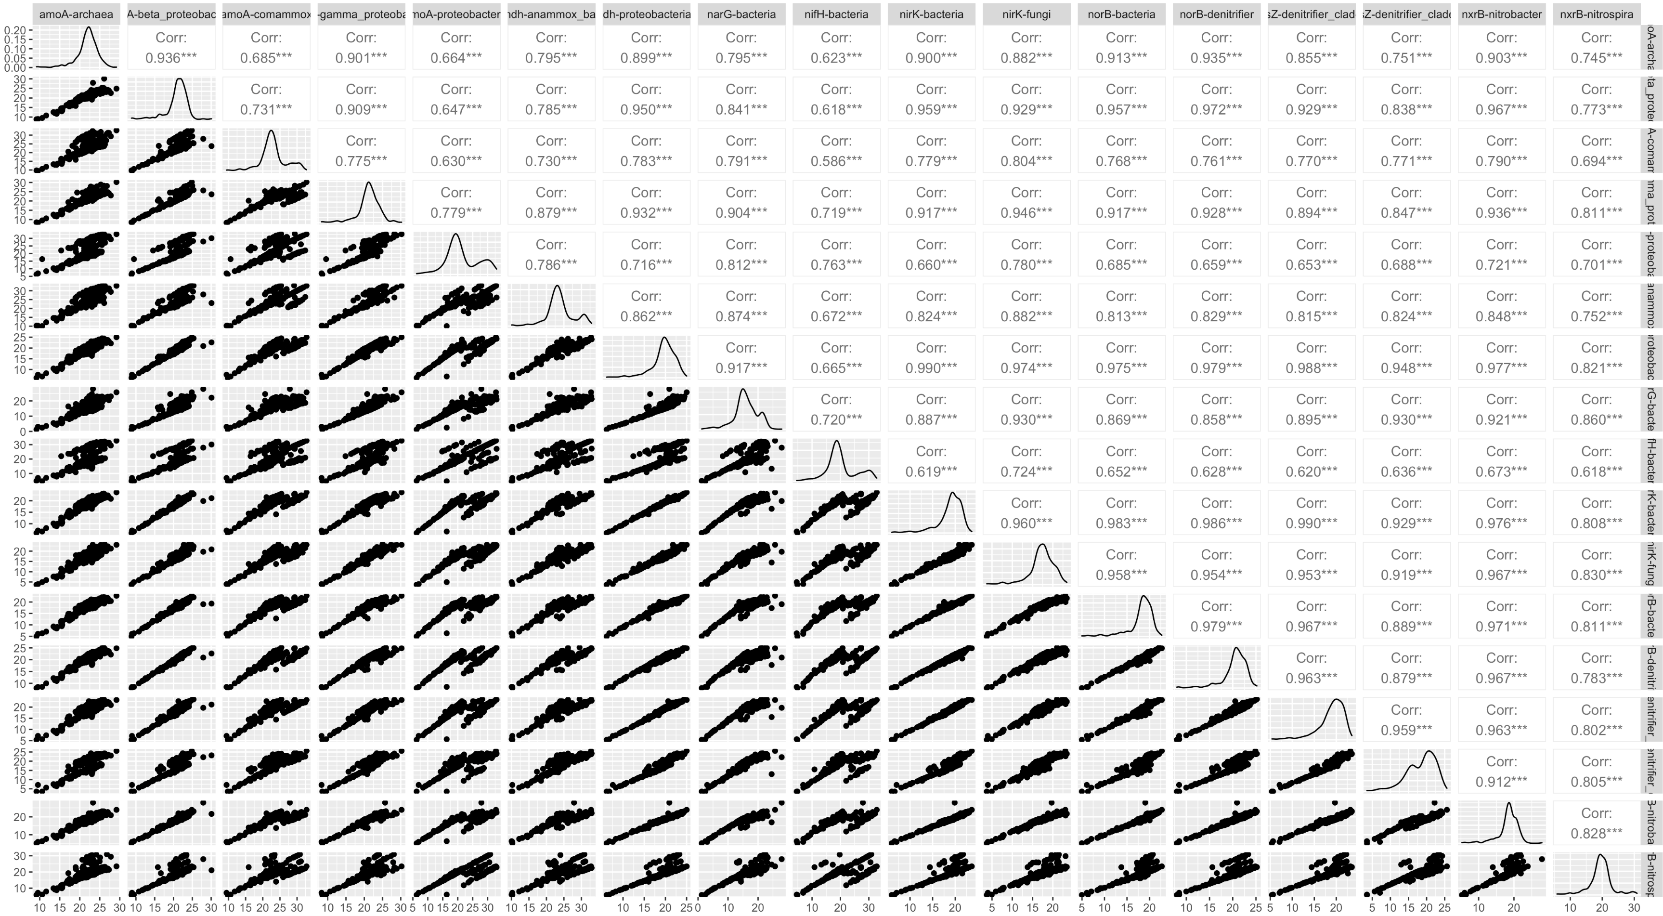

Slide 34
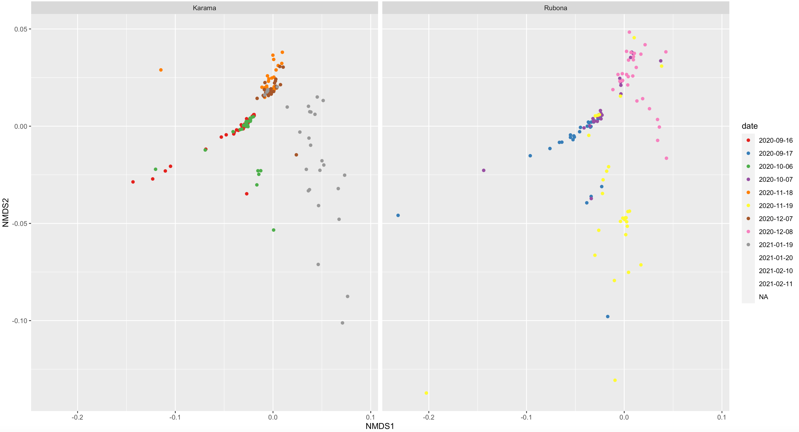

Slide 35
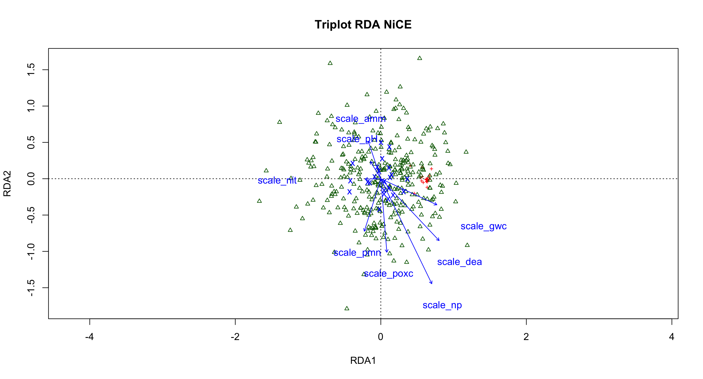
Notes:
Full model: nice_ord_1 <- rda(trim_otu ~ scale_np + scale_dea + scale_amm +
scale_nit + scale_pmn + scale_poxc +
scale_gwc + scale_pH +
factor(treatment) + factor(harvest) +
Condition(block:location:date),
data=trim_samp, na.action = na.exclude)

Slide 36
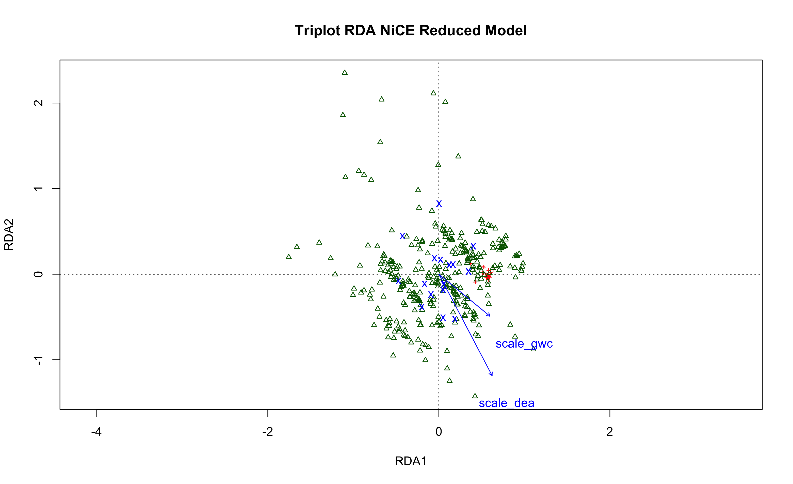
Notes:
Reduced model when conditioning for block:location:date
trim_otu ~ Condition(block:location:date) + factor(harvest) + scale_dea + scale_gwc
NP does not account for sig more variation (p=0.158)
Include in 5-min talk
Adj R2 for reduced model: 0.076

Slide 37
Notes:
Reduced model when conditioning for block:location:date
trim_otu ~ Condition(block:location:date) + factor(harvest) + scale_dea + scale_gwc

Slide 38
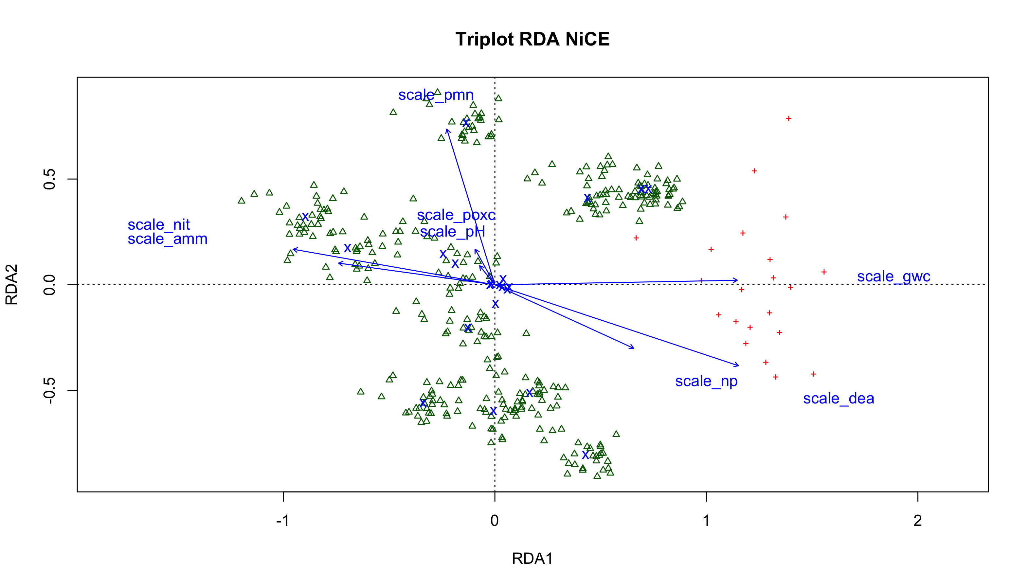
Notes:
Full model with all variables:
nice_ord_1 <- rda(trim_otu ~ scale_np + scale_dea + scale_amm +
scale_nit + scale_pmn + scale_poxc +
scale_gwc + scale_pH +
factor(treatment) + date +
Condition(block:location),
data=trim_samp, na.action = na.exclude)

Slide 39
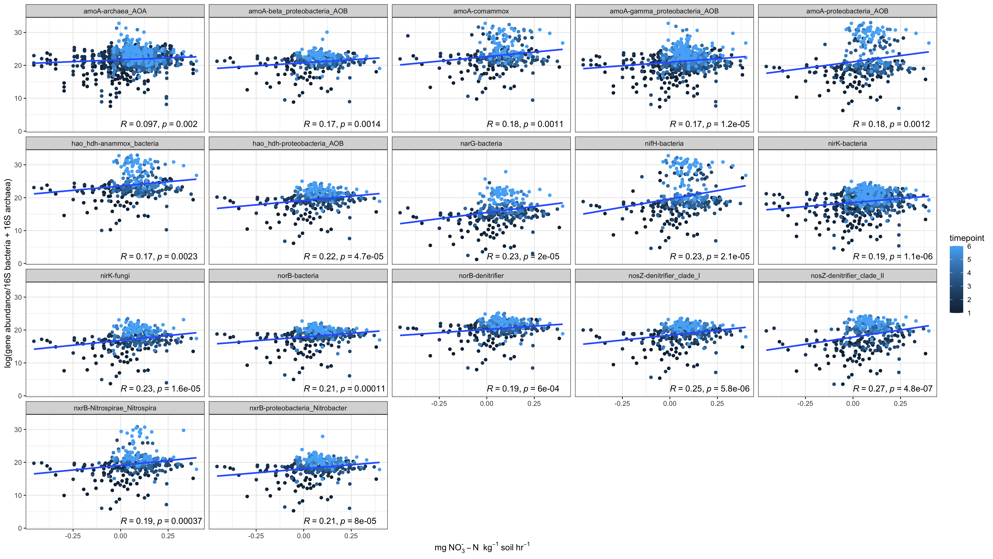
Notes:
NP ~ gene_org, color=timepoint
Include in 5-min talk

Slide 40
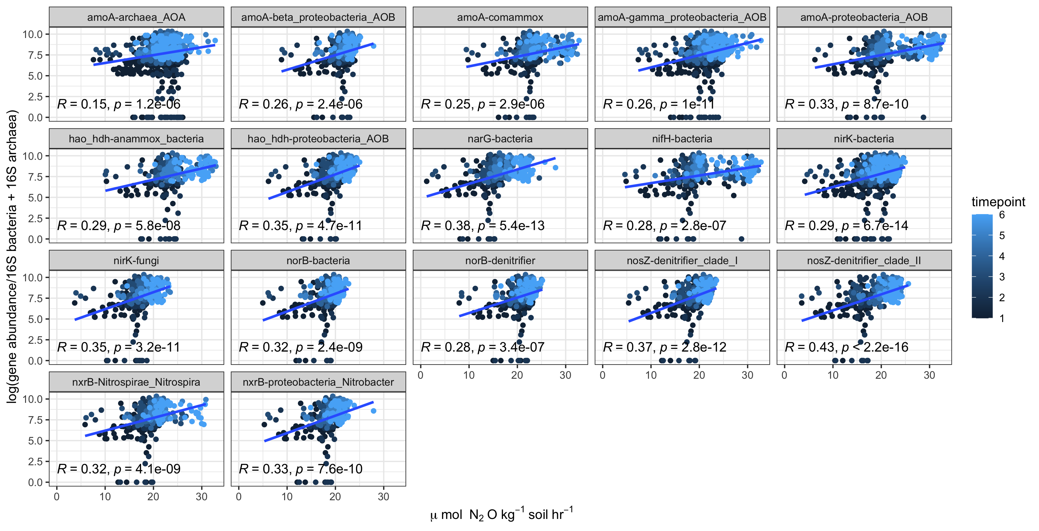
Notes:
Log_dea ~ gene_org, color = timepoint
Include in 5-min talk; generate graph with p-vals and r

Slide 41
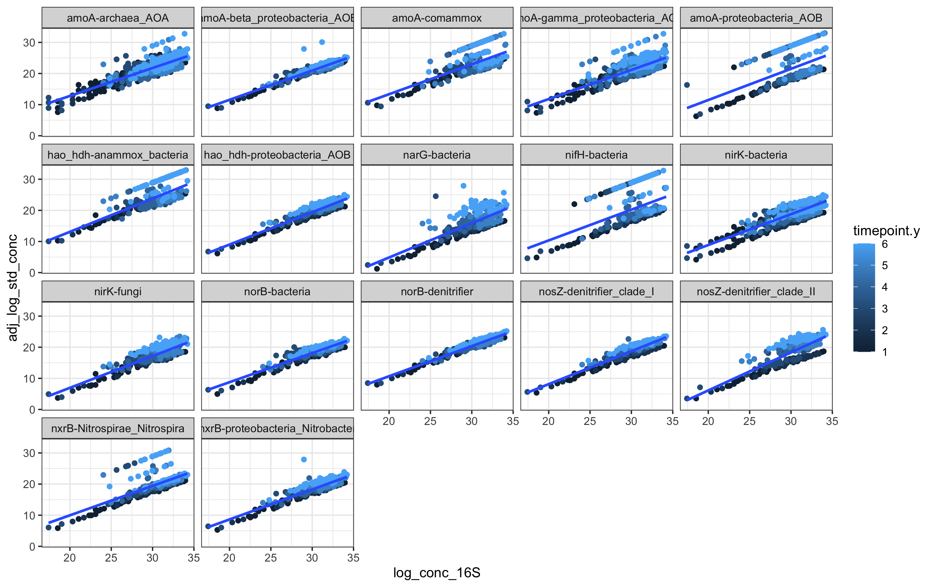
Notes:
Very highly correlated to bacterial 16S gene abundance, which increases with each timepoint

Slide 42
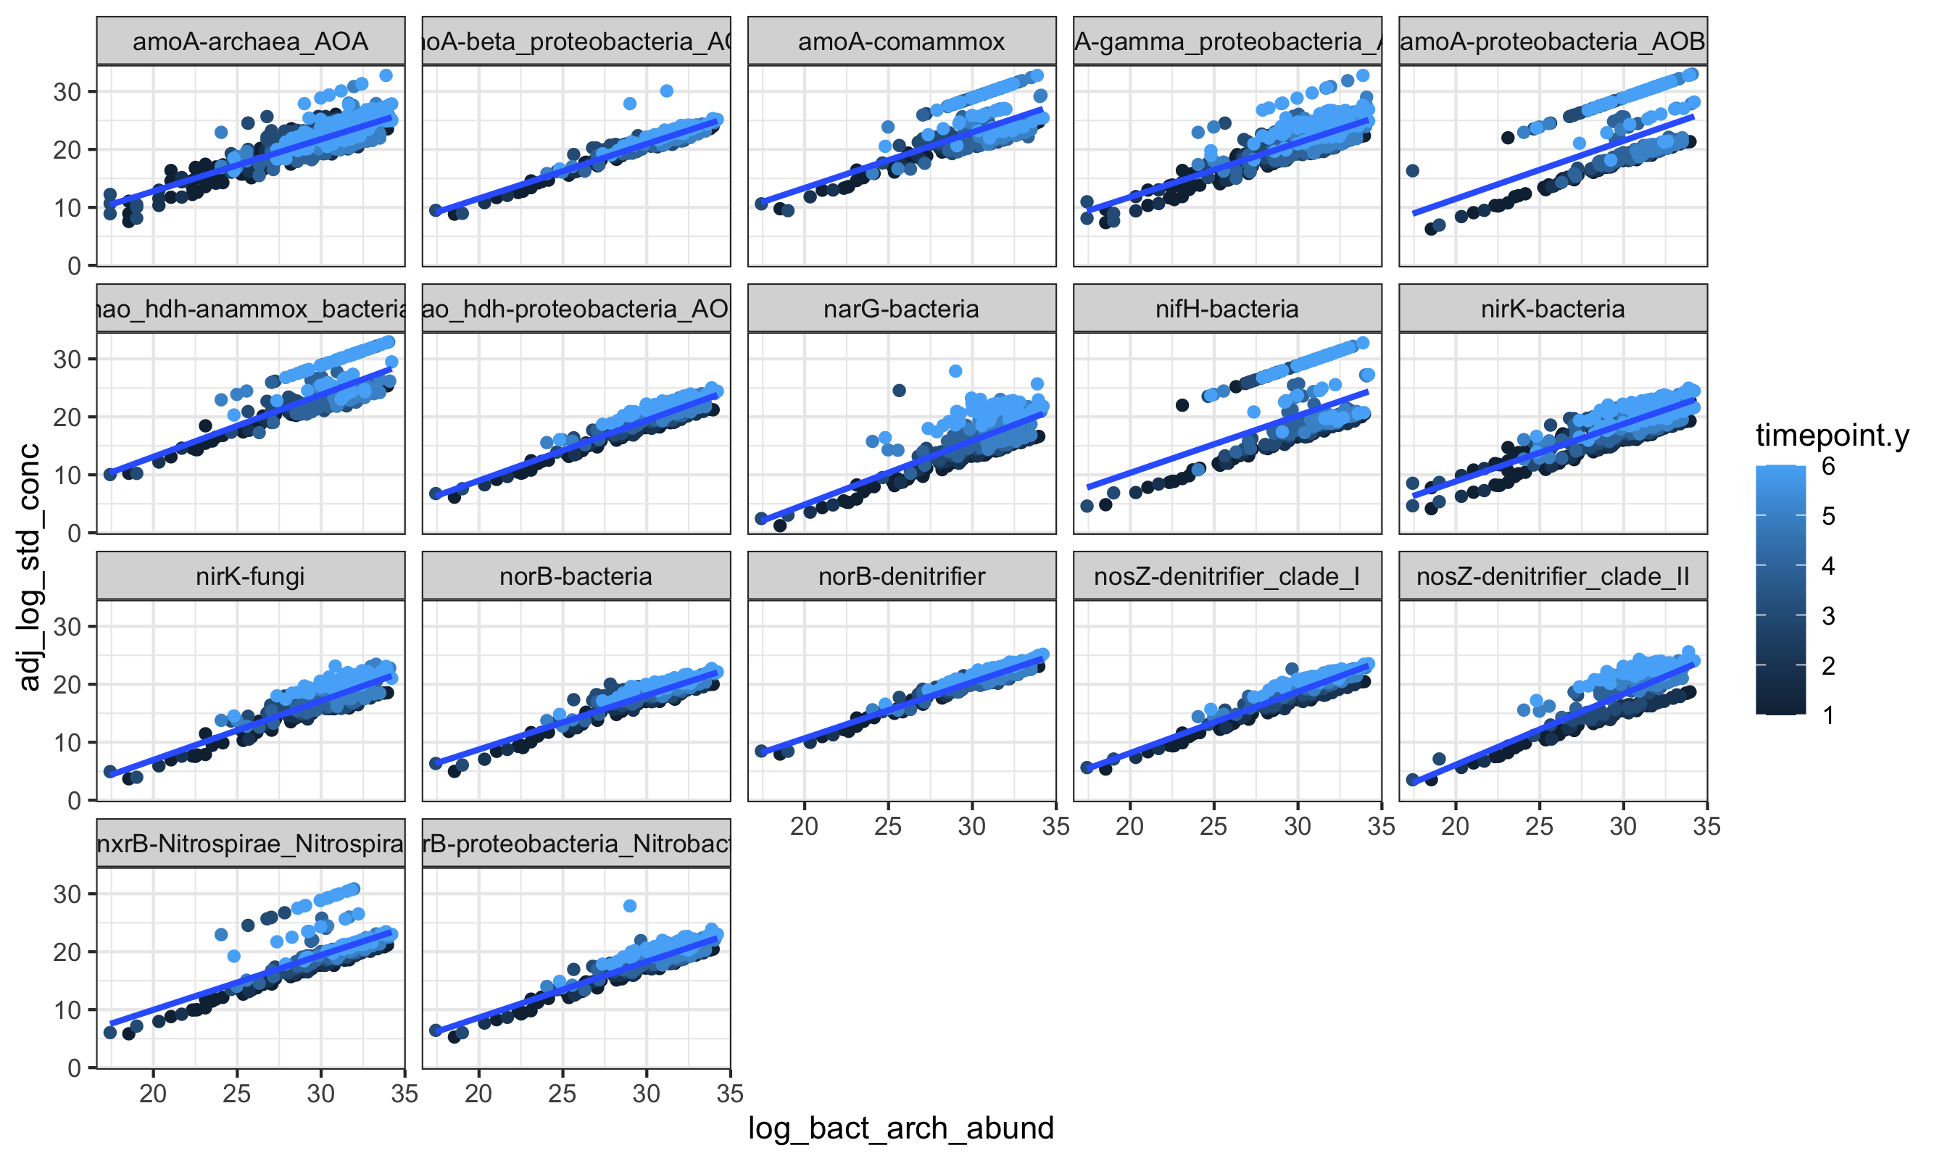
Notes:
Combined bacterial and archaeal gene abundance
Include in 5-min talk; generate p-vals and r

Slide 43
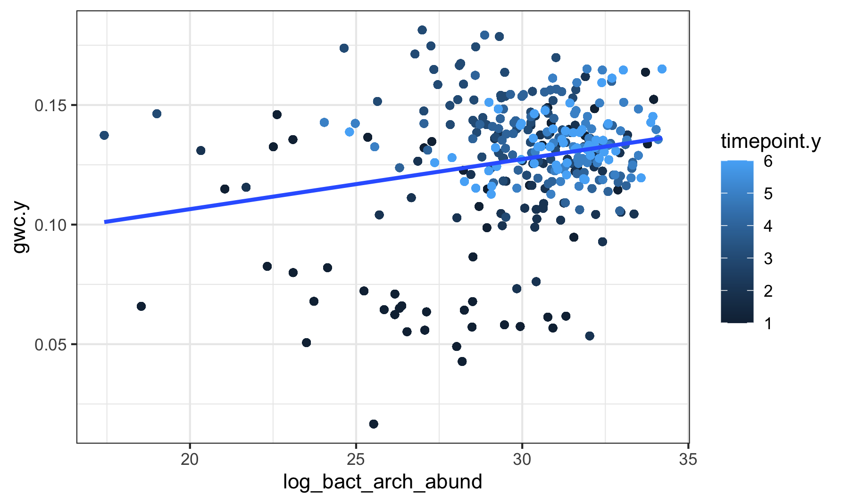
Notes:
Gwc vs bacterial/archaea abundance

